Slide 1
Proper Scanning Procedures

Slide 2
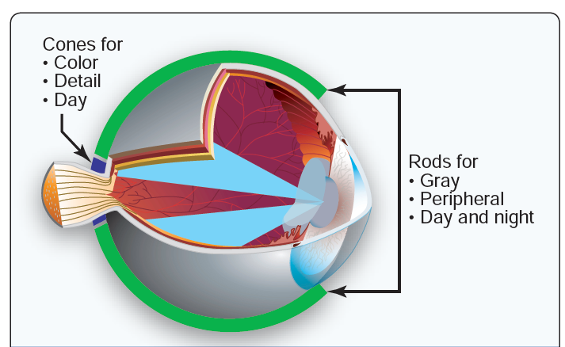
Use of the Cones & Rods

Slide 3
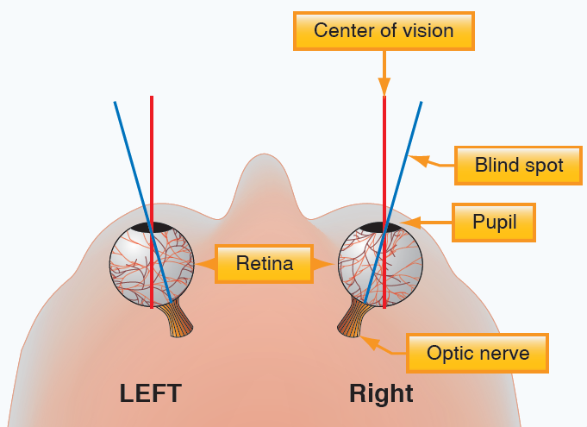
Best Day Vision (Cones active)

Slide 4
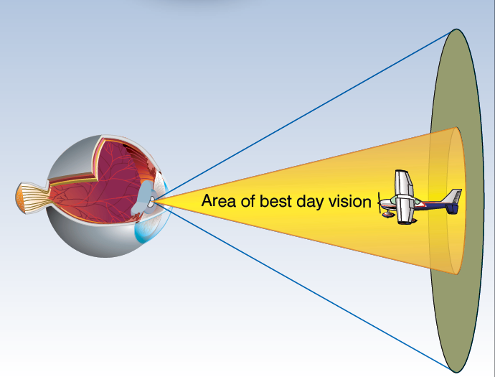
Best Day Vision (Cones active)

Slide 5
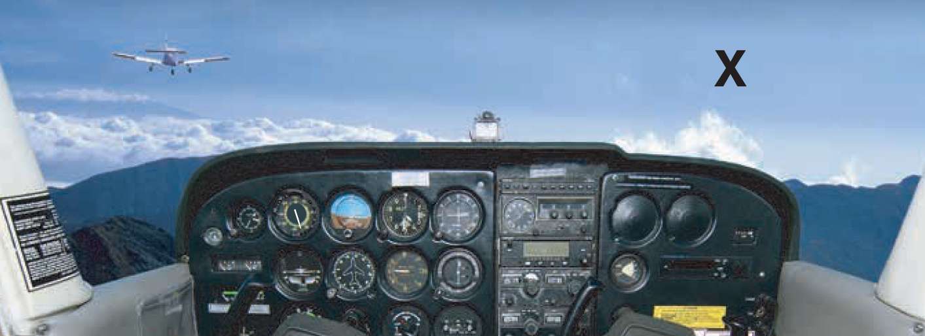
Best Day Vision (Cones active)

Slide 6
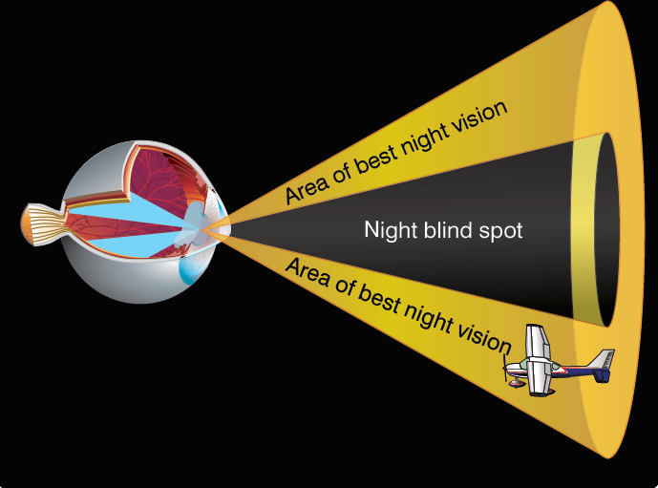
Best Night Vision (Rods active)

Slide 7
Proper Scanning Procedures
      Day - Effective scanning is accomplished with a series of short, regularly spaced eye movements that bring successive areas of the sky into the central visual field.
      Night - Looking from left to right or right to left to use peripheral vision of the rods

Slide 8
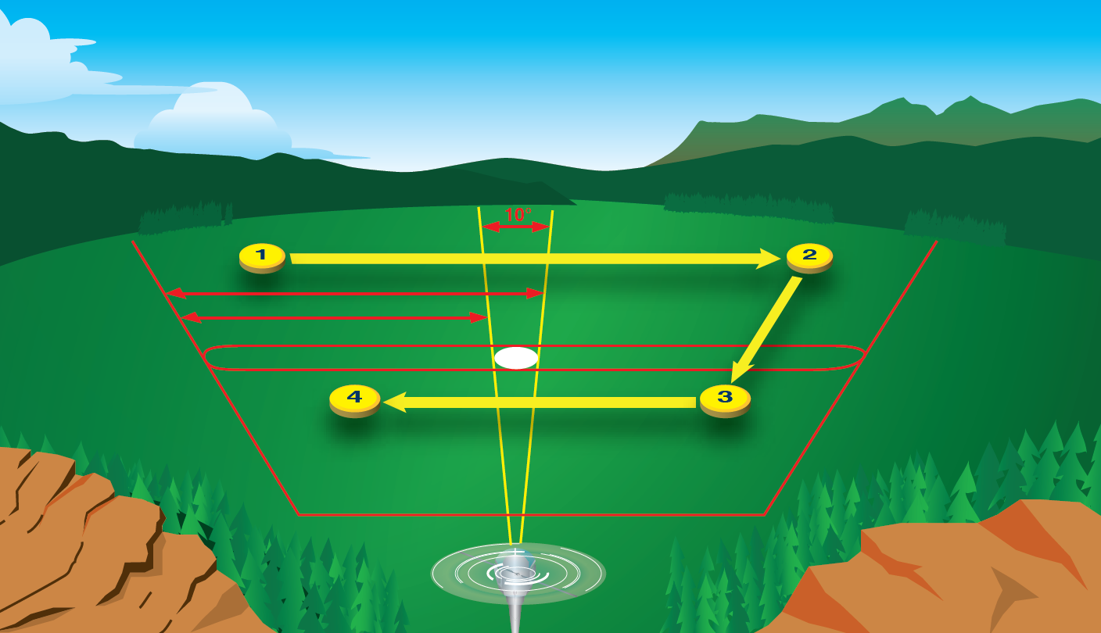
Night Scan

